Slide 1

Living Income 101 - Palm
SPOD 2025

Slide 2
What is Living Income ??
1

Slide 3


Living income, defined
The net annual income required for a household
in a particular place
to afford a decent standard
of living for all members
of that household
Living income goes beyond poverty alleviation that focus on basic subsistence and survival.

Slide 4
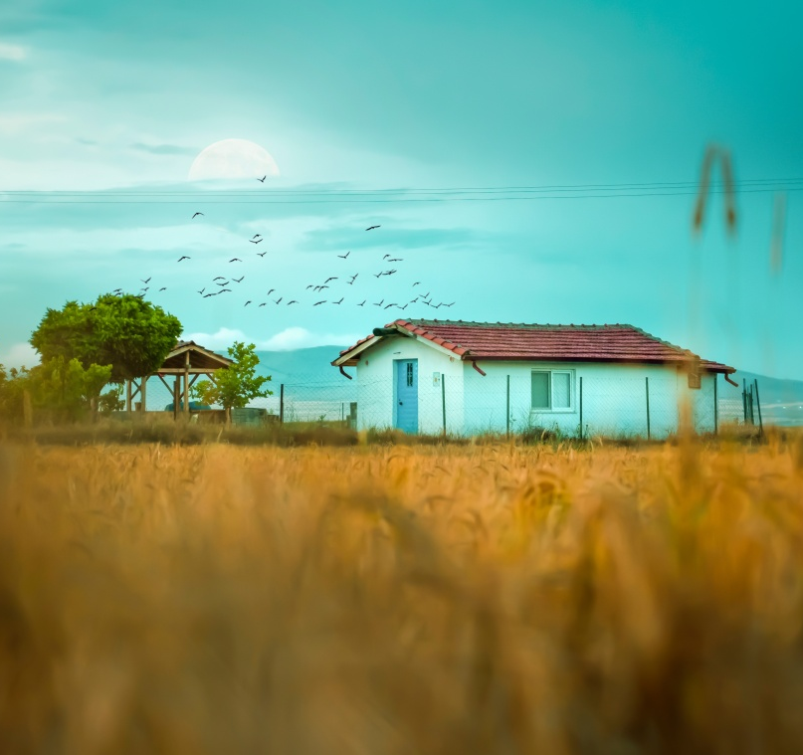







How is
a living income calculated?
Food
Housing
Education
Health care
Transportation
Basic costs for the Family
All costs are local
Other essential needs
including provision for unexpected events

Slide 5









Living Income as a Target
Prosperous income
Living Income
Costs of a decent standard of living
SDG1:
Elimination of extreme poverty
National poverty line

Slide 6


What is the living income gap?
$250
$200
$50 / 20%
Living Income Benchmark
Actual Income
Living Income
Gap

Slide 7






Living
income
Living
wage
Self-employed
farmers
Hired worker
Achieving a decent standard of living
All sources of
income from adults
in a household (annual)
Wages from
adult earners in
a household (monthly)

Slide 8
Why Farmers’ Income Matters
2

Slide 9






Global urgency for SHF and workers
Cost
of living
Climate
change
Inequality
Security of
Supply
Income
gains
Poverty
Wealth
distribution
Small-holder
farmers contribution
60%
630
45.6%
30%
of world’s food
production by SHF
World’s
poorest
million people earning less than
Responsible for total Palm oil supply
5%
USD
$3.20
570 million
3 - 7 million
Share of income
gains since 1980
Wealth accumulation
by the richest 1% in 2021
Small-holder farmers
2 billion people’s livelihoods supported
per day
Notes:
A typical oil palm plot is below five hectares, despite the fact that the threshold for smallholder farmers is set at 25 hectares in Indonesia and at 40 hectares in Malaysia
Smallholder farmers account for an estimated 27 percent of the total cultivated land area and between 25 and 30 percent of global production
These smallholders are developing their operations independently from the large plantations. They organize themselves in farmer groups, cooperatives and associations to collect and sell their fresh fruit bunches (FFB) to the mill that offers the best price. Or they depend on intermediaries for selling their produce as well as for access to inputs and credit.
Many smallholders are attracted to growing oil palm for its greater yield and potentially higher prices, as well as the fact that it can be harvested year-round, providing a steady cash flow. Compared to other commodities like cocoa, coffee or tea, oil palm is seen as a profitable crop and price is rarely the subject of public debate. This is likely linked to the fact that palm oil is generally more profitable compared to other crops and that, in most cases, smallholders have larger plots than their peers in other crops.
Palm oil companies rely on the RSPO for implementing sustainability and smallholder inclusivity in the palm oil value chain.59 While RSPO is an important multistakeholder platform to drive improvements in the palm oil value chain such as labor standards and the recognition of rights of indigenous communities, it does not have a good track record with respect to smallholder inclusivity. The number of smallholders included in certified value chains is low; in September 2024, independent smallholders made up 2.5 percent of RSPO certified volume,60 representing around 50,000 smallholders61 and around 130,000 hectares of RSPO certified land (2.5 percent of all RSPO certified land). New data from the RSPO suggests there has been a remarkable growth in numbers of certified smallholders in recent years, however this still represents only a few percent of all global smallholders.
We are currently seeing three key developments that make the topic of smallholder inclusivity particularly relevant: 1. increasing vulnerability to climate change-related extreme weather events 2. increasing price volatility 3. increasing sustainability requirements

Slide 10
Sustainability potential beyond income
Notes:
Ambitious LI results CAN support / positively reinforce
Environmental improvements / forest protection
Mitigating other human rights violations, like child labor
…others?
Food security
HEALTHY ENVIRONMENT and food system

Slide 11
Stakeholder Incentives
3

Slide 12





Enhance brand value and build
stronger reputation
Secure customer loyalty and
attract new customers
Lead on SDGs
(1, 2, 3, 4, 6, 7, 8, 11)
Increase market share and
command higher prices
Improve supply volumes and quality specifications
Meet due diligence
and reporting requirements
Receive more favourable financing terms from investors and unlock
new sources of financing
Incentivize new producers
leverage opportunities
BUSINESS
INCENTIVES
Human rights
Reputation
Supply security
mitigate risks
Underpayment of farmers
and farm workers
Controversy and
negative publicity
Destabilized supply chain actors undermine quality and delivery
Use of forced labor
or child labor
Consumer boycotting
Low return on
sustainability investments
Divestment and costlier
access to credit
Notes:
Social license to operate companies need this.
Human Rights
Leverage Opportunities:
All of us working to achieve the SDGs is really important, wherever your business is along the supply chain, alongside governments and civil society.
With pressure now through legislation, reporting will become easier. There is an option to opt for traceability too.
Mitigate risks
The cotton sector is also well known for using child labour – so that families can earn a decent income each day. This is particularly true during the harvest season and worker families who migrate into the area to pick cotton. While child labour is illegal, for these vulnerable communities, there is no choice, unless they they are paid a living wage and farmers are paid the fair price.
Reputation
The fashion industry is highly competitive and one of the ways of differentiating oneself is to make choices that would help build a favourable reputation with consumers. Consumers have begun to make choices to buy from companies that are ethical and care for producers.
Investors are also getting interested in companies that have the edge on the social and environmental front. Such investment is also an incentive to make changes along the value chain and therefore create a positive market presence, and get a better share of the market.
Supply security
Climate change is creating havoc in the lives of cotton farmers and therefore supporting them with better prices, training, and help to move to sustainable practices will help companies to secure their supply. All cotton countries are affected by climate change and the volume of cotton produced is reducing. Due to challenges of the market as well as costs of production increasing, cotton farmers are beginning to move to other crops which will further reduce the supply of cotton on the world market. For the long-term survival of the fashion industry and other industries dependent on cotton, it is important that companies work together to find solutions to support the needs of cotton farmers.

Slide 13

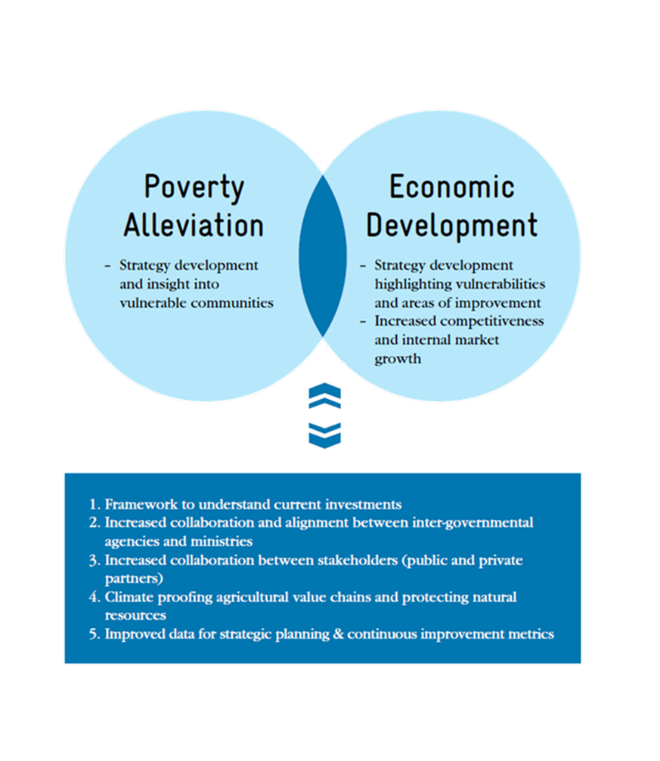
Producing
Country Incentives
  Higher savings, spending and investment and maximize contributions to state income, taxes, food security and overall economic development
  Lower public costs ie Reduction in cost of subsidies and other government inutrition, childhood morbidity, migration, etc.
  Higher farm investment can lead to higher production & reduced supply risk
  Address other human right issues like Child labor
  Help with environmental goals like adoption of sustainable agricultural practices and reduce undesirable coping strategies like deforestation
Source: LICOP (2022)

Slide 14
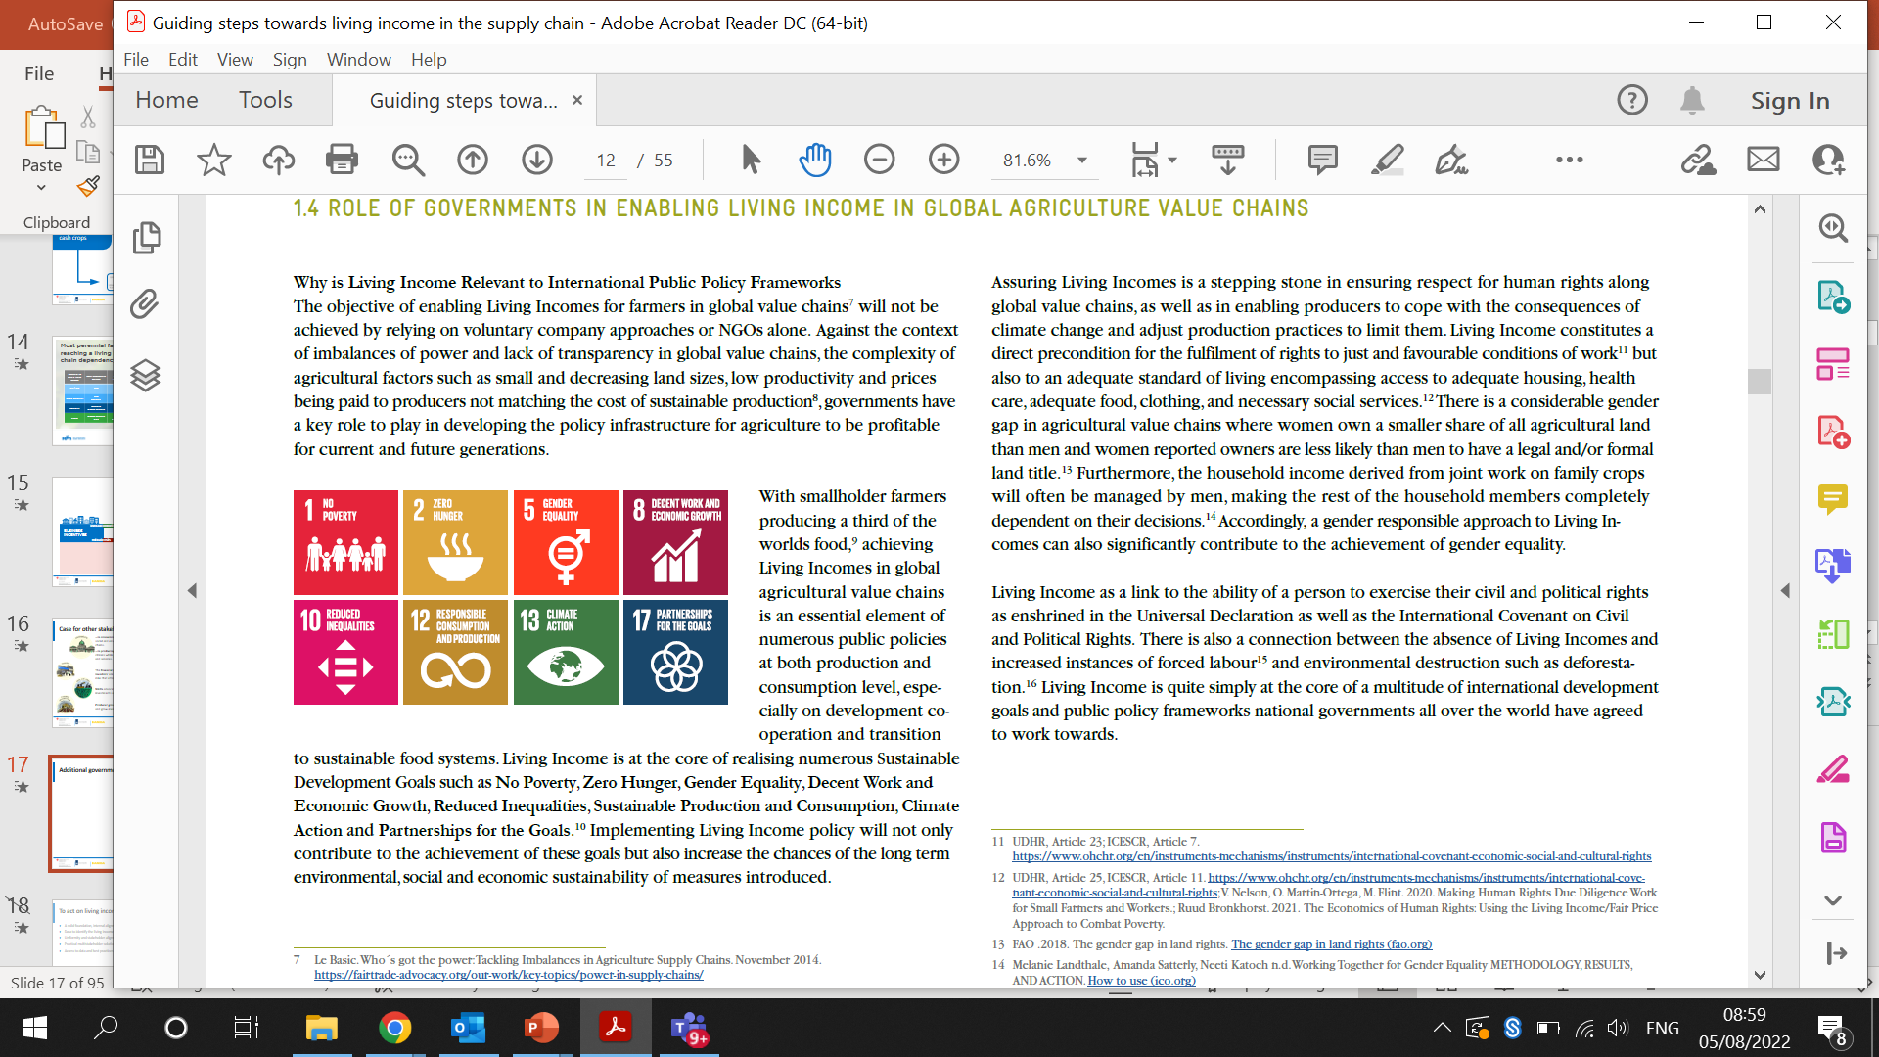
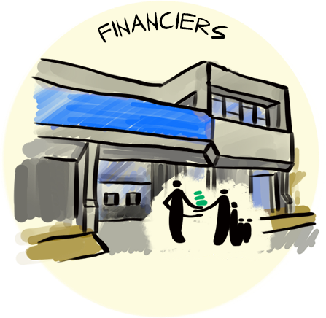

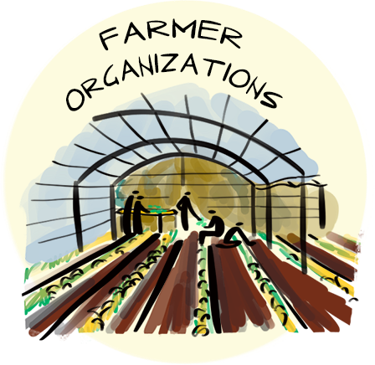
Incentives for other stakeholders
Consuming countries respond to citizen pressure and seek access to affordable goods that fulfil social and environmental responsibilities. Help political commitment to SDGs.
The financial sector has a unique opportunity to create a new investor class among smallholders; while investors’ are seeking ESG and financial returns that actively mitigate human rights and environmental risks that attract consumers.
NGOs can deliver better on sustainability and human rights goals while also advocate, educate and influence decision-makers at macro and micro levels about their policies, investments and purchasing decisions to.
Producer groups can retain and grow membership by serving member needs better as they are critical link to markets and services for their members;

Slide 15
Applied Learnings
4

Slide 16
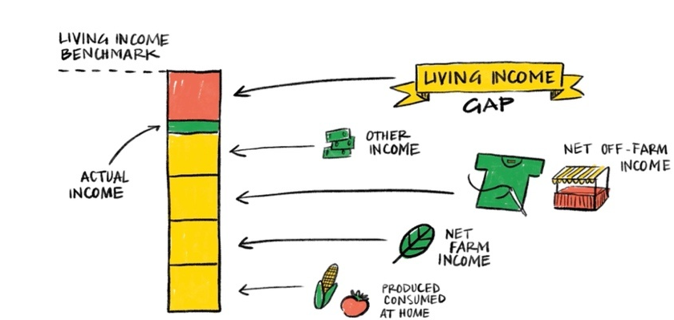
Insight 1: Household income is often diversified

Slide 17
Moving towards Living Income
Need a different approach beyond farmer and focus crop to close LI gaps
Farm production focus
Living Income
Household
Household
Farm enterprise
Farm enterprise
Farmer
Farmer
Focus crops
Other crops
Off-farm
Focus crops
Other crops
Off-farm

Slide 18





Insight 2: Build your strategy on most relevant income drivers
COST OF
PRODUCTION
DIVERSIFIED
INCOME
HOUSEHOLD
INCOME
LAND
VOLUME
PRICE
FOCUS CROP - PALM
Notes:
The implementation of a pricing mechanism formula that’s often prescribed by local or national governments.
• The world market price, as the FFB-price received by smallholders often relies on global prices.
• Size of the farm.
• Productivity level.
• Labor costs.
• The price farmers pay for inputs like fertilizer and pesticides also depend on global market prices.
• Whether the farmer or agent is selling to intermediaries or directly to the mill.
• The state and availability of local infrastructure and transport logistics
• The number and capacity of mills that can be reached before the FFB starts to deteriorate.
• The reliability and fairness of weighing scales and quality control procedures.
• The objective assessment of FFB grading by the mill and how transparent it is about its grading system.
• The Oil Extraction Rate (OER), which in turn relies on the quality of the FFB.

Slide 19


For Palm: relevant parameters of income drivers
Context determines which are most relevant
COST OF
PRODUCTION
DIVERSIFIED
INCOME
LAND
VOLUME
PRICE
Size
Land tenure
Use/management
Productivity & yield
Loss The Oil Extraction Rate (OER) (depending on quality of the FFB)
Number and capacity of mills reachable before deterioration of FFB
Relaibility and fairness of weighing and quality control procedures
Tree age
FFB dependency on global prices
Role of intermediaries (Vs selling directly to mills)
Objective assessment and transparency of FFB grading by mills
Consideration for differentiation across quality
Cost of input like fertilizers and pesticides(impact of global trends)
Labor Costs
State of local infrastructure and transport logistics
Other net on-farm income (non-focus crop)
Net off-farm income
Other income
Notes:
The world market price, as the FFB-price received by smallholders often relies on global prices.
• Labor costs.
• The price farmers pay for inputs like fertilizer and pesticides also depend on global market prices.
• Whether the farmer or agent is selling to intermediaries or directly to the mill.
• The state and availability of local infrastructure and transport logistics
• The number and capacity of mills that can be reached before the FFB starts to deteriorate.
• The reliability and fairness of weighing scales and quality control procedures.
• The objective assessment of FFB grading by the mill and how transparent it is about its grading system.
• The Oil Extraction Rate (OER), which in turn relies on the quality of the FFB.

Slide 20
Insight 3: Developing stable diversified income sources is an essential strategy
COST OF
PRODUCTION
DIVERSIFIED
INCOME
HOUSEHOLD
INCOME
LAND
VOLUME
PRICE
FOCUS CROP

Slide 21






Insight 4: “Smart-mix” of strategies across stakeholders is essential
The range of factors that together create the context in which different stakeholders operate, and which can facilitate production, sourcing, processing, service provision, marketing, rural development and social welfare.
Engagement between private sector or government and households/farmer groups at origin, focusing on production and processing.
Enabling environment
Production & processing
Strategies and actions requiring alignment, coordination and/or collaboration across the sector and/or landscape.
Sector & Landscape management
Procurement PRACTICES
Sourcing principles
and actions.
Smart-mix of strategies
Efforts and technologies that enable information to be shared across the value chain and among stakeholders.
Efforts around marketing, branding and product innovation.
Traceability & transparency
consumer engagement
& PRODUCT INNOVATION
Notes:
In order to deliver results at farm level with multiple income drivers, stakeholders need to change their behavior at various levels – their own behavior (ie business practice), at national and/or landscape level, and at sector level.
This means strategies that can improve income drivers go far beyond addressing changes in the farm system and household behavior.
These strategies range from service delivery for improved production and processing, to brand and consumer engagement, to improving the enabling environment. See below for 6 strategic areas that multiple stakeholders can address in their multistakeholder intervention strategy.
Each of these strategies should influence an improvement in one or multiple income drivers, or the underlying conditions that enable an improvement in income drivers.
As you iterate on feasible values and the impact it has on income, the more exploration you might have to do to identify appropriate strategies.

Slide 22
Insight 5: Data is a necessity and crucial foundation
Don’t let perfection get in the way of progress: start with what you have: fill gaps and build specificity and granularity over time
Go fast alone, or go far together: bring stakeholders along during data discovery and analyses processes to build buy-in and accountability from the start
For maximum impact, develop evidence-based strategies using primary and secondary data and data modeling, and document assumptions to compare to results
Align pre-competitively and Share publicly (according to GDPRS) to promote a data-sharing ecosystem that is more efficient, collaborative and resource efficient over time

Slide 23
Thank you
Vaibhav Panpaliya
Senior Innovation Manager – Better Income

