Slide 1
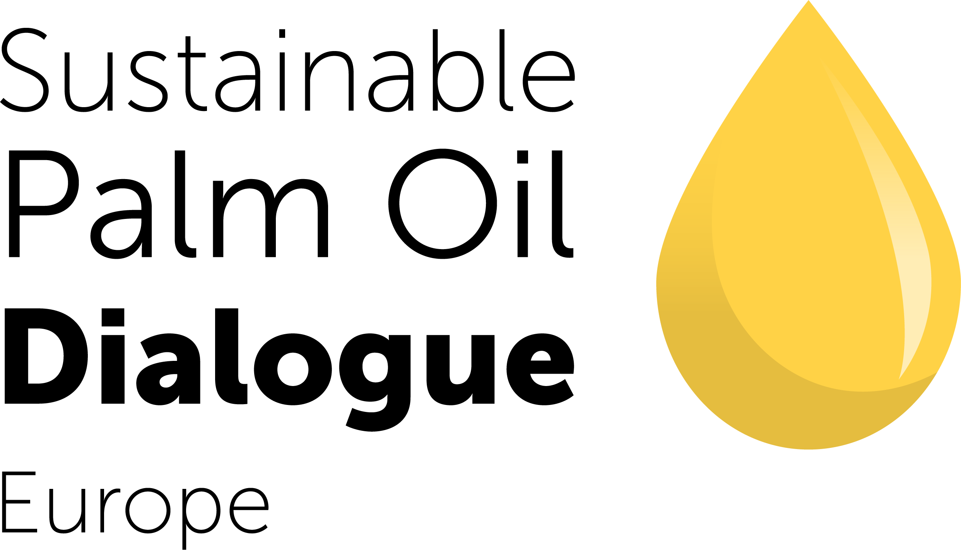
BEST PRACTICES SESSION
Annelotte Crena De Iongh
Head of Development
Source Up
Landscapes Approaches
Carolina Fontes
Program Manager Circular and Bioeconomy
Clariant
This session will explore how different actors engage with landscape approaches—what value they derive, how social inclusion is factored in, and how progress is tracked. The discussion will anchor around palm oil landscapes as a use case and offer insights into real-world examples, evaluation frameworks, and investment strategies.
Katie Kenrick
Global Lead - Human Rights
Earthworm Foundation
Moderated by
Billie Wilcox Brooke
Sustainability Innovation, Associate Manager
ISEAL

Slide 2
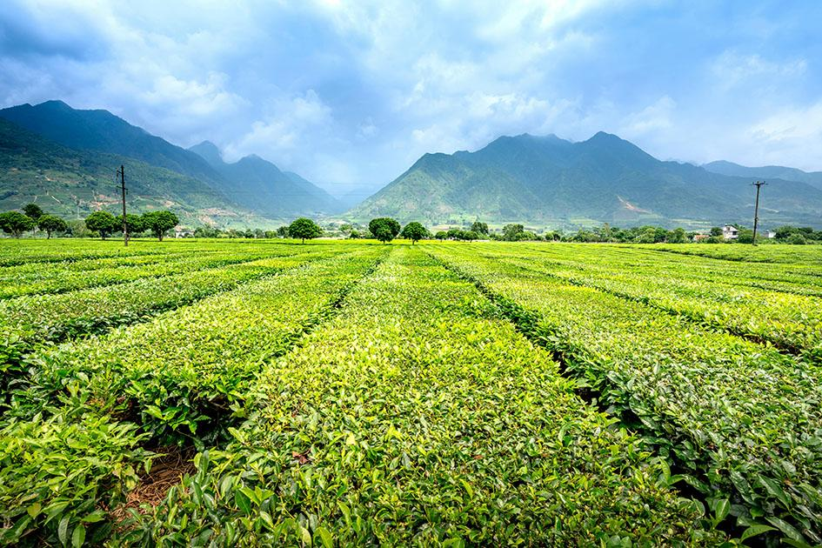
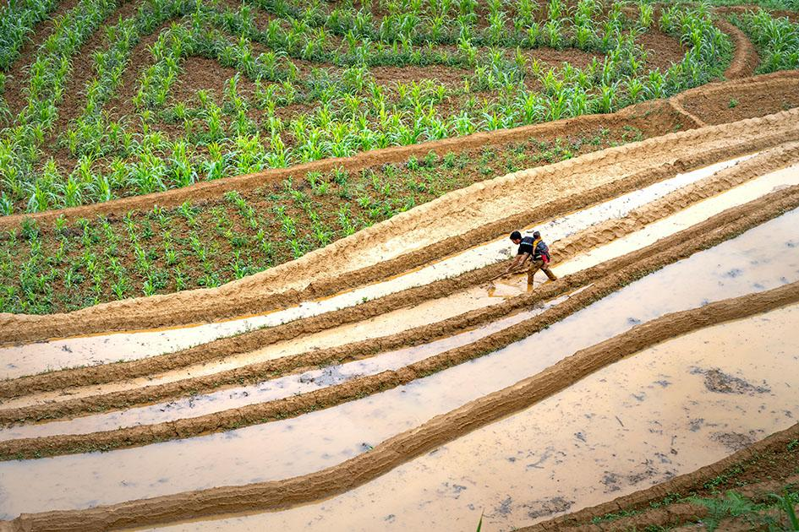
Landscape Definitions
Image © Quang Nguyen Vinh/Pexels
Image © Quang Nguyen Vinh/Pexels
Image © Adobe stock
Landscape
Landscape Approach
Landscape Initiative
Socio-ecological system, defined by a geographic area with common and interacting ecological and socioeconomic characteristics. A landscape may be delineated based on river basins, seascapes, ecosystems, jurisdictions, productive boundaries, or in other ways.
A management approach focused on multi-stakeholder collaboration to advance shared sustainability goals and build resilience at landscape scale.
The multi-stakeholder initiative that operationalizes a landscape approach in a particular landscape, by setting common goals, taking collective action while reconciling different interests, and monitoring progress towards shared sustainability goals and outcomes at a landscape scale.
Source: https://isealalliance.org/get-involved/resources/core-criteria-mature-landscape-initiatives-2024

