Slide 1
Sustainable Palm Oil Dialogue 2025
Implementing Due Diligence in Supplier Engagements
Valentine Prevot, Lead Sustainable Palm Index

Slide 2






Action for Sustainable Derivatives
Scaling-Up Efforts Through Collaboration
A collaborative organization
facilitating the production and sharing of information, data, and solutions
to accelerate transformation of the overall sector
A shared objective & ambition: A palm derivatives supply chain that
Is free from deforestation
Respects human rights
Supports local livelihoods

Slide 3



Suppliers engagement
A key step for sector transformation
Supplier Engagement consists of all the “activities, investments, processes, procedures and methodologies that a buyer intends to implement to ensure that its suppliers comply with the buyer’s social and environmental commitments and obligations”, According to the AFI.
GOOD PRACTICES
Get involved in collaborative initiatives
Assess suppliers
Use assessment results
Identify gaps and areas for improvement
On their policies and commitments
but also on their procedures, achievements and progress towards sustainability
As complex issues can hardly be addressed by engaging only your suppliers
To go beyond your supply chain
For example, jurisdictional approaches, sectoral or broader multi-stakeholder initiatives
Review progress
Suppliers implementation plan
Provide
support to suppliers
purchasing decisions​

Slide 4


The Sustainable Palm Index | An engagement tool
Created in 2016 by and
Used within the ASD - Action for Sustainable Derivatives - since 2019.
6 SPI campaigns since 2019
An evaluation scorecard for direct & indirect suppliers of palm products, that aims to:
Assess suppliers’ progress and areas of improvement in terms of supply chain knowledge, responsible sourcing practices, commitments and actions taken to address the major stakes related to the palm oil supply chain.
140 palm suppliers currently evaluated by the SPI
Integrated
Oil & Derivatives
Support higher involvement and improvement on these commitments and their operational deployment.
Derivatives
Distributors

Slide 5









The SPI | Built on multi-stakeholder dialogue
Questionnaire review
Human Rights
Sectoral alignment
SPI becomes an
ASD tool
2016
2019
2020
2021
2022
2023
2024
2025
126
139
117
117
Evaluated suppliers
87
Created by
30
X

Slide 6
The SPI | A tool with multiple purposes
For buyers
Procurement and sustainability teams
A due diligence tool: in-depth understanding of supplier practices to identify, prevent and mitigate risks in the supply chain
Support to engage suppliers​ toward progress by identifying positive results and areas for improvement ​
Support for purchasing decisions​
A common framework facilitating dialogue
For Suppliers
The SPI enables suppliers* to:
The SPI is valued by suppliers as a tool that supports them in their journey
towards sustainability
64%
Better understand of sector evolutions and expectations
42%
Gain expertise on sustainability topics within the palm oil sector and identify topics to be prioritized internally
39%
Prepare for upcoming regulations (including EUDR)
*Results of the survey conducted in November 2024 among suppliers evaluated by the SPI (42 respondents)

Slide 7




The SPI | Encourages dialogue at each step
Supplier inputs
Suppliers’ Initial SPI submission
ASD Preliminary Feedback
Preliminary score & detailed feedbacks communicated to suppliers.
Suppliers update anwers
for Final Submission
ASD Final Feedback
Final feedback on updated answers
Final score communicated
Help in prioritizing actions
ASD Support Module
Additional support for supplier in their Due Diligence with operational tools and individual working sessions
ASD feedbacks
Beyond an evaluation tool, the SPI aims at supporting suppliers journey towards sustainability by creating an on-going exchange and providing collective and individual support for concrete progress.

Slide 8
The SPI | Engaging suppliers on Human Rights
Apart from a dedicated section on Human Rights,
the SPI covers Human Rights questions in 4 different categories:
1
Deforestation and conversion
6
Timebound Implementation Plan & Governance
9
Grievances management
2
Human rights
3
Climate change
7
10
Certification
Traceability & Transparency
4
Biodiversity
8
Supplier evaluation & engagement
11
Landscape actions
5
Water

Slide 9
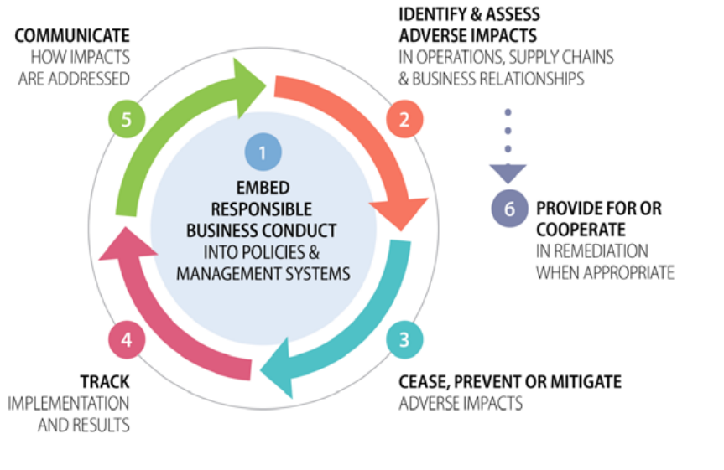
The SPI | A Human Rights Due Diligence Tool
Grievances management
In each theme, the questions cover the different steps of a due diligence procedure:
  Does your company have a public grievance mechanism? What is the scope?
  What is the governance within your company ? Is there a grievance committee ?
1
  Does your company have implemented dedicated channels to get a notification from non-compliance cases?
2
3
  Engagement of non-compliant suppliers? Providing support? Suspension?
  Are there any minimum requirements for re-entry after suspension?
4
  Monitoring, verification, and reporting of suppliers actions plan and performance?
5
  Communication of the grievance mechanism publicly or to relevant stakeholders?
  Existence of a public grievance log?
6
  Corrective measures following non-compliances? (Compensation or remediation)
  Collaborative action to support the management of a grievance?

Slide 10
SPI 2024 | Results on grievances management
Integrated
Oil & Derivatives
Remediation
Remediation
Wide disparity between suppliers, with a maturity in grievances management that decreases with the player downstream position in the supply chain
Integrated players, positioned upstream, are the most mature.
This is positive for the sector as a whole, since the commitment of integrated players benefits downstream suppliers.
The engagement of downstream players remains key to cascading requirements
Derivatives
Distributors
Remediation
Remediation

Slide 11
Thank you

