Slide 1
From policy to impact
Best practices from across sectors Anne Manschot, Senior consultant SPOD, 21 May 2025

Slide 3
Do no harm
Due diligence in a nutshell
Notes:
All human rights

Slide 4
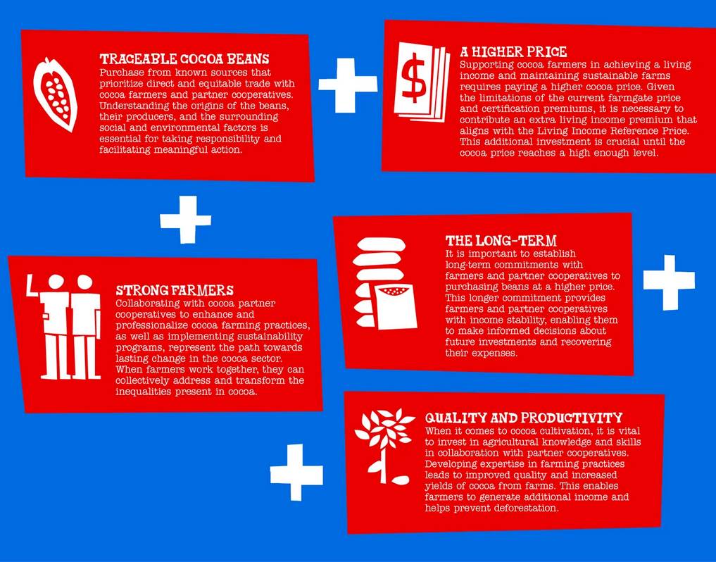
It may start with a policy…
1
Values first
Enables you to withstand external pressure
2
Senior buy-in
Upholding the policy, even when it hurts
3
Communicate
The more you say it, the more it sticks

Slide 5
… but is only meaningful with integration
Know your supply chain
Act on the findings
Ensure support

Slide 6
… but is only meaningful with integration
Know your supply chain
Act on the findings
Ensure support
“Our buyers and sustainability team together visited high risk suppliers in Colombia. We were told we were the first of their customers to ask questions about human rights. We discussed their human rights due diligence, governance and implementation. We also spoke with local NGOs to help us understand the local context and place our findings in a larger perspective.”

Slide 7
… but is only meaningful with integration
Know your supply chain
Act on the findings
Ensure support
Earning a living wage “works as a catalyst to avoid other risks in our supply chain, such as excessive overtime and child labour.”
Zeeman started a pilot to pay living wages at selected sites where they were a large buyer. Collaborating with Fair Wear Foundation and other brands (Schijvens and Prenatal), they increased their leverage to include more sites.

Slide 8
… but is only meaningful with integration
Know your supply chain
Act on the findings
Ensure support
Supplier sustainability at Philips is built around their Supplier Sustainability Performance programme. This way, the company moves beyond audits and instead works with suppliers to provide training and supporting them to make improvements.
“It is rooted in collaboration and transparency, and encourages others in the supplier network and industry to adopt the approach.”

Slide 9
Create a solid policy and use it to do no harm.

Slide 10
THANK YOU!
Anne Manschot Senior consultant
info@wevaluechange.com
+31 6 20 62 69 55

