Slide 1
Corporate Contentious Politics: Palm Oil Companies and Land Conflicts in Indonesia
Ward Berenschot,
Professor of Comparative Political Anthropology,
KITLV & University of Amsterdam
w.j.berenschot@uva.nl

Slide 2
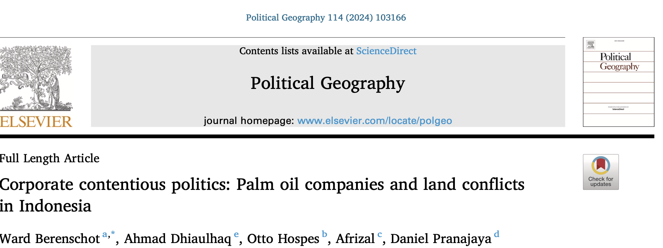

Slide 4
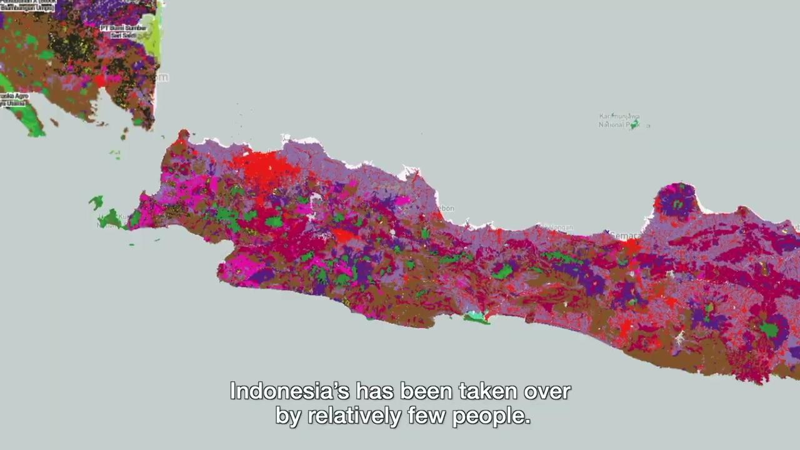

Slide 5
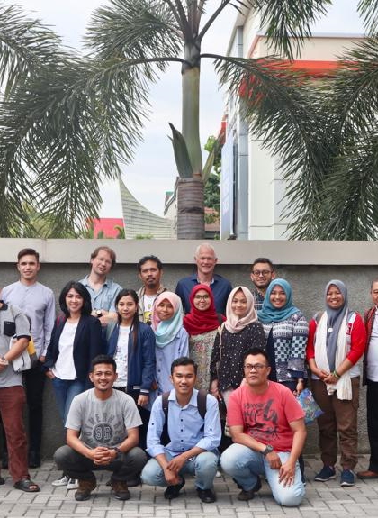
Method
A team of, in total, 19 researchers traced the emergence, chronology and outcomes of 150 conflicts by collecting written sources (newspaper articles, online sources, government and NGO documents and academic studies) as well as engaging in 283 interviews with community leaders.
Focus: West Kalimantan, Central Kalimantan, Riau and West Sumatra
Cases were largely selected randomly out of a long list of 544 conflicts prepared by NGO partners.
As part of these efforts we used the complete newspaper archives of four regional newspapers – Padang Express, Pontianak Pos, Kalteng Pos and Tribun Pekanbaru – for the years 2010 to 2019.
Descriptive statistics presented in this paper is based on coding of ‘case reports’ written on the basis of this material

Slide 6
How often do communities succesfully address their grievances?
Outcomes of 150 conflicts between communities and palm oil companies, 2000 - 2019
 | West Sumatra | Riau | West Kalimantan | Central Kalimantan | Total (150 cases)
No success at all | 9 (36%) | 23 (48%) | 12 (38%) | 13 (29%) | 57 (38%)
Barely | 7 (28%) | 10 (21%) | 9 (28%) | 19 (42%) | 45 (30%)
Partially | 4 (16%) | 9 (19%) | 7 (22%) | 9 (20%) | 29 (19%)
To a large extent | 5 (20%) | 5 (10%) | 4 (13%) | 3 (7%) | 16 (11%)
Fully successful | 0 (0%) | 1 (2%) | 0 (0%) | 1 (2%) | 2 (1%)

Slide 7
Grievance handling procedures
Companies have adopted Standard Operating Procedures (SOP’s) that tell company staff how to deal with community grievances
Conflict/Grievance Handling Units, tasked with resolving conflicts
Supporting and promising to adhere to industry standards, in particular the ‘Principals and Criteria’ adopted by the Roundtable on Sustainable Palm Oil.

Slide 8
But: corporate conflict behaviour at the plantation-level
1. the co-optation of village elites to circumvent informed consent
2. the cultivation of close relationships with local authorities
3. the suppression of protests
4. the criminalization of protest leaders.

Slide 9
1. Co-optation of village elites to circumvent informed consent
According to Indonesian Law & RSPO standards, companies are required to obtain consent before developing land. This is often circumvented, by:
Relying on, and supporting, community leaders and to assume that their signature represents the consent of the whole community
Employing community members to persuade their neighbours to relinquish their land.
Sometimes, fraudulent behaviour
If that does not work: supporting alternative community leaders to divide the community

Slide 10
2. Cultivation of Collusive Ties with local authorities
Ex-company employee: “As humas [‘community liaison’]my most important task was to give uang jatah (‘gratuity’) for the kapolsek [head of police), koramil [local military commander], village heads and camat [sub-district head]. A monthly incentive. We gave the village heads 500 thousand rupiah [40 USD] per month, the head of the local police and the sub-district head got 1 million [80 USD]. This is outside the [financial] aid we give when there is a meeting. (…) This is just to [make the activity] succeed, so that there is no obstacle for the expansion [of the plantation]. And when there is Idul Fitri or Christmas we also make a donation to them. (…). And the bupati gets even more, he gets 10 million (Interview, 8 September 2017).

Slide 11
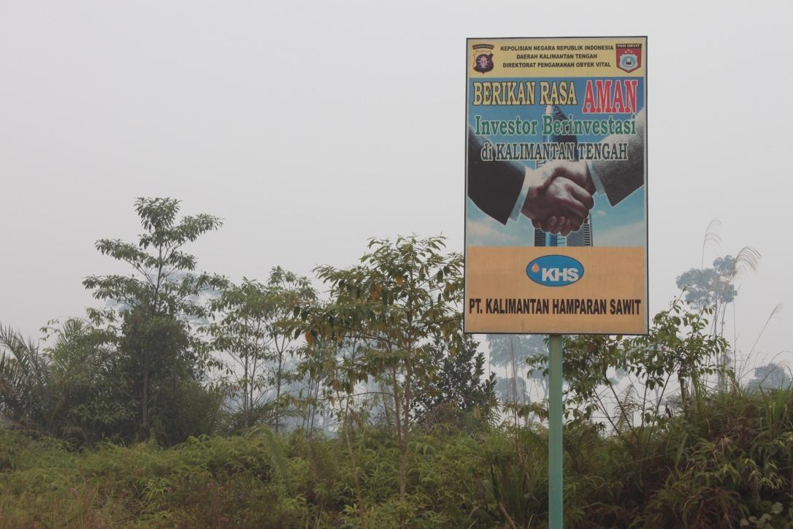
These informal ties between plantation managers and state officials can take various forms:
Monthly ‘contributions’ to village heads, state officials, and police.
Financial contributions to election campaigns of politicians
Payments for ‘organisational costs’ to the police and army for their presence during protests
Head of conflict resolution division of a palm oil company:
So when there is a conflict, when the company asks for security support [from the police], they will give [a budget] proposal. And it makes it more costly. So when my team was working [to resolve the conflict], the police seemed upset because they lost their jobs. Lost their source of income too. Because now there is no more conflict

Slide 12
3. Supression of Protests
In our documentation of 150 conflicts, we documented 69 instances where community protests were met with violence from the local police, mobile police brigade (Brimob) or preman ('thugs’) (of which 16 cases also involved violence from community
This violence led to 16 deaths and 195 wounded villagers
Company representative: ”If needed, we ask not only the police, but also local government officials for help. We start with approaching the civil servants, such as the regional government’s secretary for help to discuss issues with community leaders, and to convey suggestions to the community to move [to another location]. If not successful, the approach may become harder, that is, by using the security apparatus”. (Interview with the sustainability team of a company, Jakarta, 20 February 2020).

Slide 13
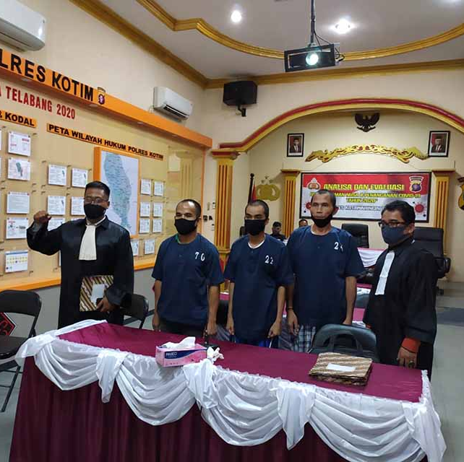
4. Criminalization of Community Leaders
We documented 789 arrests of community members during the course of 150 conflicts
Accusations: defamation, harvesting of palm oil bunches, falsifying documents, ‘organising disturbances’
Jail sentences: usually between 2 months and one year, yet communities win about half of these court cases

Slide 14
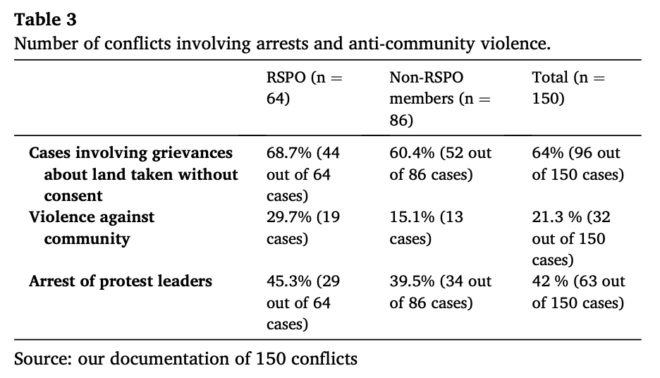
How common are these forms of corporate contentious politics?
🡪 RSPO member companies do not behave differently compared to non-RSPO member companies

Slide 15
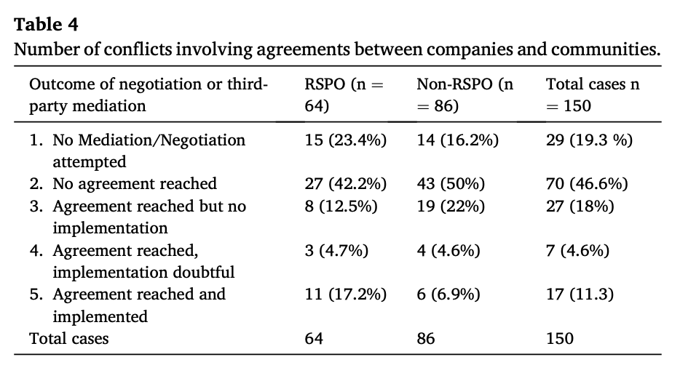
How often are palm oil conflicts resolved through a mutual agreement?
In short, no real difference: RSPO companies reached agreement in 34% (22/64), non-RSPO also in 34% (29/86) of cases

Slide 16
Do RSPO certified companies behave differently?
 | RSPO certified companies (N=30) | Non-RSPO companies (N=86)
Violence against community | 27% (8 cases) | 15% (13 cases)
Arrests of protest leaders | 27% (8 cases) | 40% (34 cases)
Agreement reached? | 30% (9 cases) | 34% (29 cases)
Reported to the RSPO? | 20 percent (6 cases) | N.A.

Slide 17
Why do palm oil companies employ these practices?
To save costs? The costs of meeting community demands is unlikely to succeed the costs of bribes to police and authorities & damages to production, image.
Management problems? Local managers might adopt such practices without being instructed to do so (and without informing higher-level managers)
Our explanation: the limited legal certainty offered by highly informalized state institutions. Corporate contentious politics is likely most common in contexts where companies cannot rely on an impersonal, rule-bound implementation of laws and regulations & hence need to cultivate personal relationships with power holders.

Slide 18
Conclusions
Janus-faced corporate strategies: companies propagate high-minded sustainability standards and codes of conduct, while at the plantation-level company representatives are engaged in acts that, in effect, often violate these standards.
These strategies are not cost-saving. They are more likely motivated by need to deal with limited legal certainty & limitations of conflict resolution mechanisms.
Money spend on conflict resolution efforts (e.g. independent mediators) is a good investment, as successful agreements can reduce costs of outlays to police and state officials.

